Slide 1
React Component Architecture
Memoir of a React Developer
May 14th, 2024

Slide 2
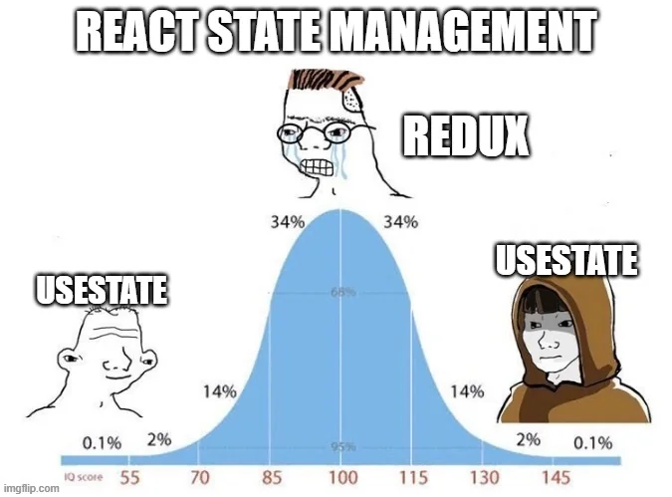
My goal today is to offer a highly opinionated take on how to design components in React.

Slide 3

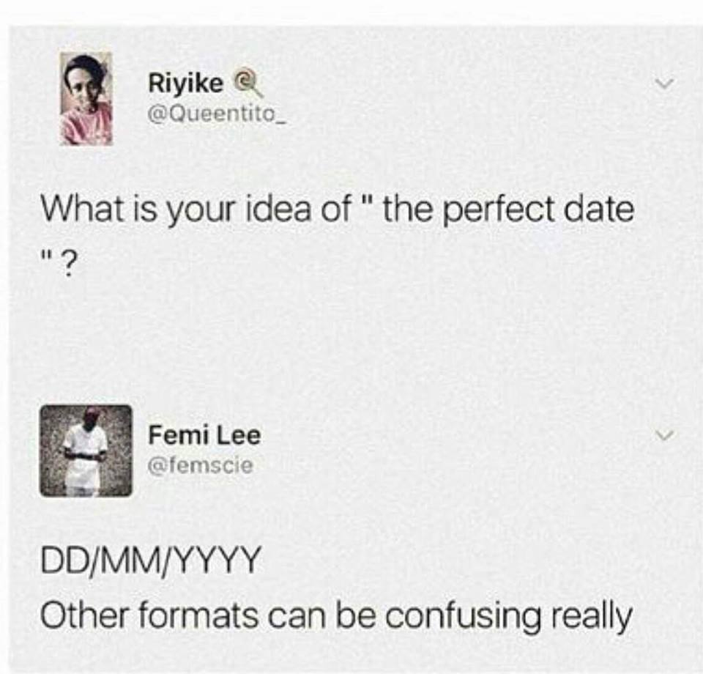

Who am I?
My name is Jonathon Tech
I am on the ICF Next Govt side of the house. My experience with React is:
~10 year of production React.
CI/CD, build systems, testing, design, and scaling.
Been front-end Architect, Lead, and Senior SE.
Nice to meet you all and thank you for letting me speak today.

Slide 4
A Word on React
React is meant to make centralization of various aspects of an applications UI easy to globally control. In other words, if it breaks it breaks everywhere — but:
If it is fixed, it is fixed everywhere.
A problem I see the most in code is, generally, some devs want to treat all the frameworks and libraries the same.
Thinking in React is different than thinking in Vue, Svelte, Solid, Qwik, Angular, etc...
The same is true of any and all frameworks/libraries.

Slide 5
Frame of Reference
Here are some the concepts that have been guiding principles when I choose to design React applications, within the context of React.
Locality of Behavior (LoB)
Here is a good article by HTMX that coined this term:
https://htmx.org/essays/locality-of-behaviour/
Self Documenting Architecture
My own term.
This concept is based on the “Self Documenting Code” idea. Here a link to familiarize:
https://swimm.io/learn/documentation-tools/tips-for-creating-self-documenting-code
Generic Design
What is a “generic” component?

Slide 6

Locality of Behavior
“The primary feature for easy maintenance is locality: Locality is that characteristic of source code that enables a programmer to understand that source by looking at only a small portion of it.”
— Richard Gabriel

Slide 7
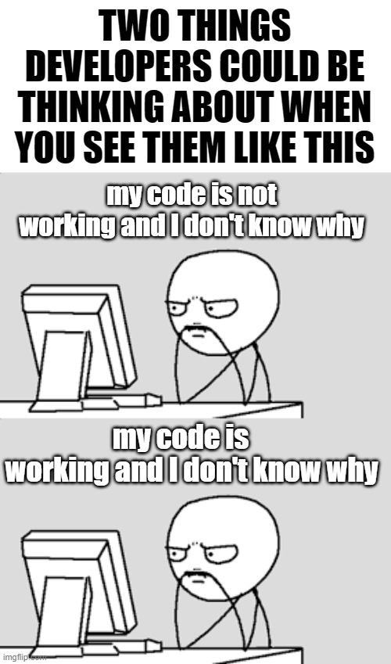
Self Documenting Architecture
Self Documenting Architect is just a way of designing the code, files, and folders in a way that aligns well with the actual way the application is implemented.
It makes things:
Clear, not clever
This just means to have as little implicitness as we can.
Follows some level of organization
The path between the file and folder is infer-able as someone gets familiar with the code.
Time spent reading the code is not time spent figuring out the meaning of the number 42
(a.k.a we aren’t trying to figure out the meaning to life)

Slide 8
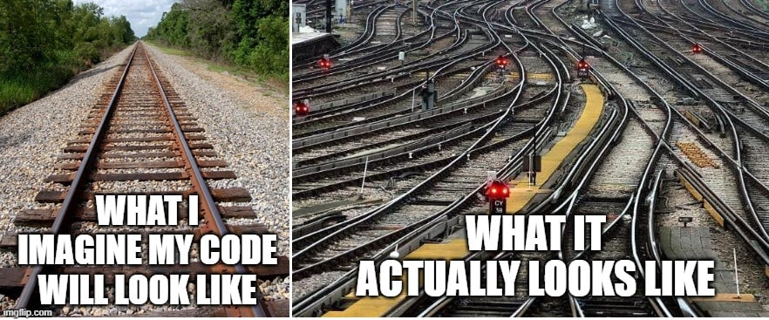
Generic Design
The entire purpose of a framework/library, like React, is to fundamentally create the most atomic elements we need, re-use them, and build upon them.

Slide 9
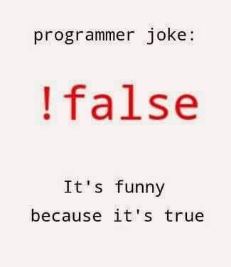
Components All The Things
Components can have:
The component itself.
Unit tests for the components.
StorybookJS support for atomic development and visual testing.
Styles.
Testing data.
Sub-components.
Any supporting files and data.
Components are containers of context, themselves.

Slide 10
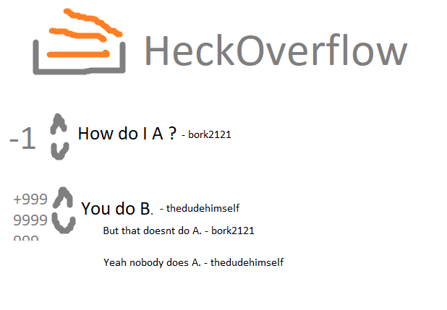
Let’s look at code...

Slide 11
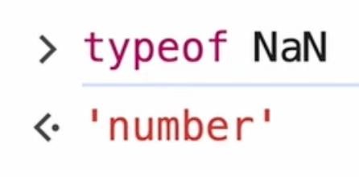
Questions?

